Slide 1

Truth’s Trail
Abhijeet Choudhary
2022CS11104
Umesh Kumar
2022CS11115
The quest of a journalist….

Slide 2
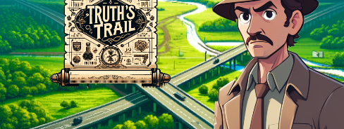
The game is based on the quest of a journalist as he sets out to expose a mega scandal by the state’s Road and Highway Minister, in the grand Arborfield-Bridgetown Intercity Expressway …

Slide 3
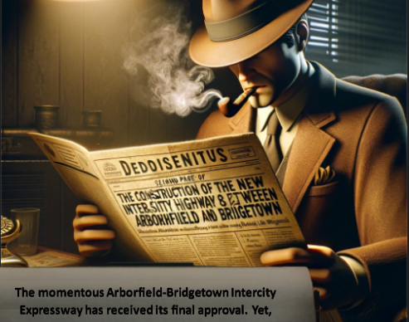
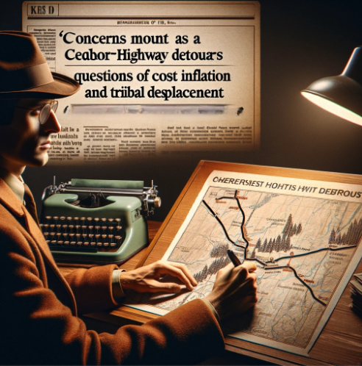
His suspicions were fueled by the highway’s Deroute through Ceabor, which resulted in significant cost increases and greater tribal displacement.

Slide 4
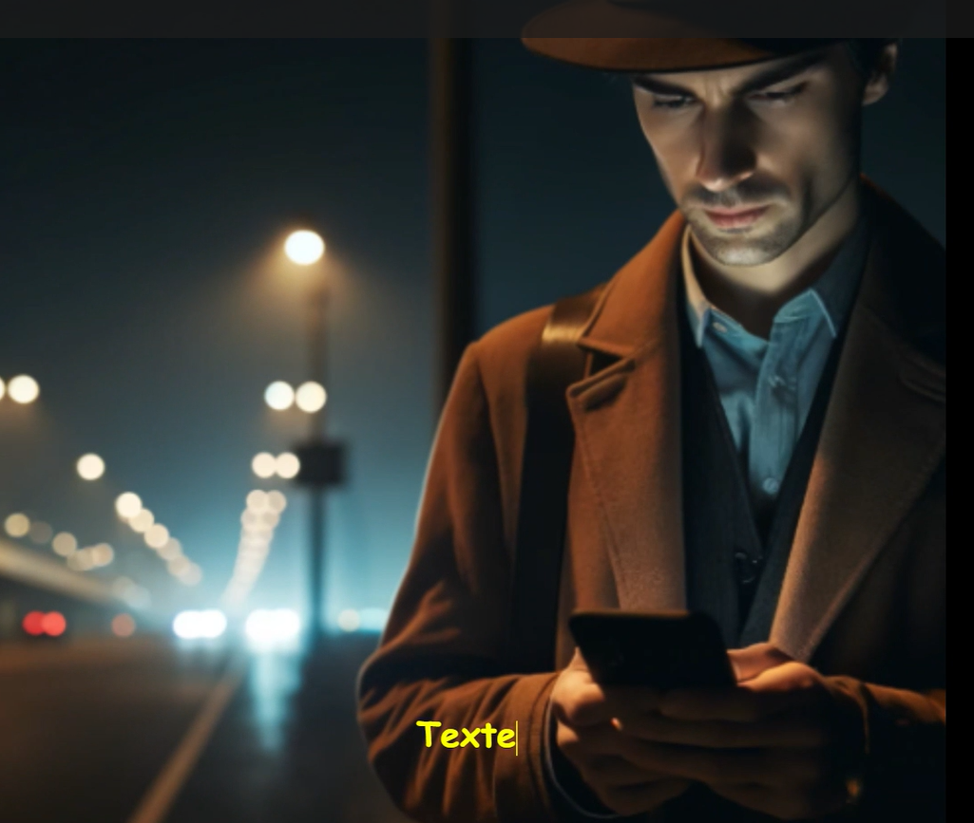
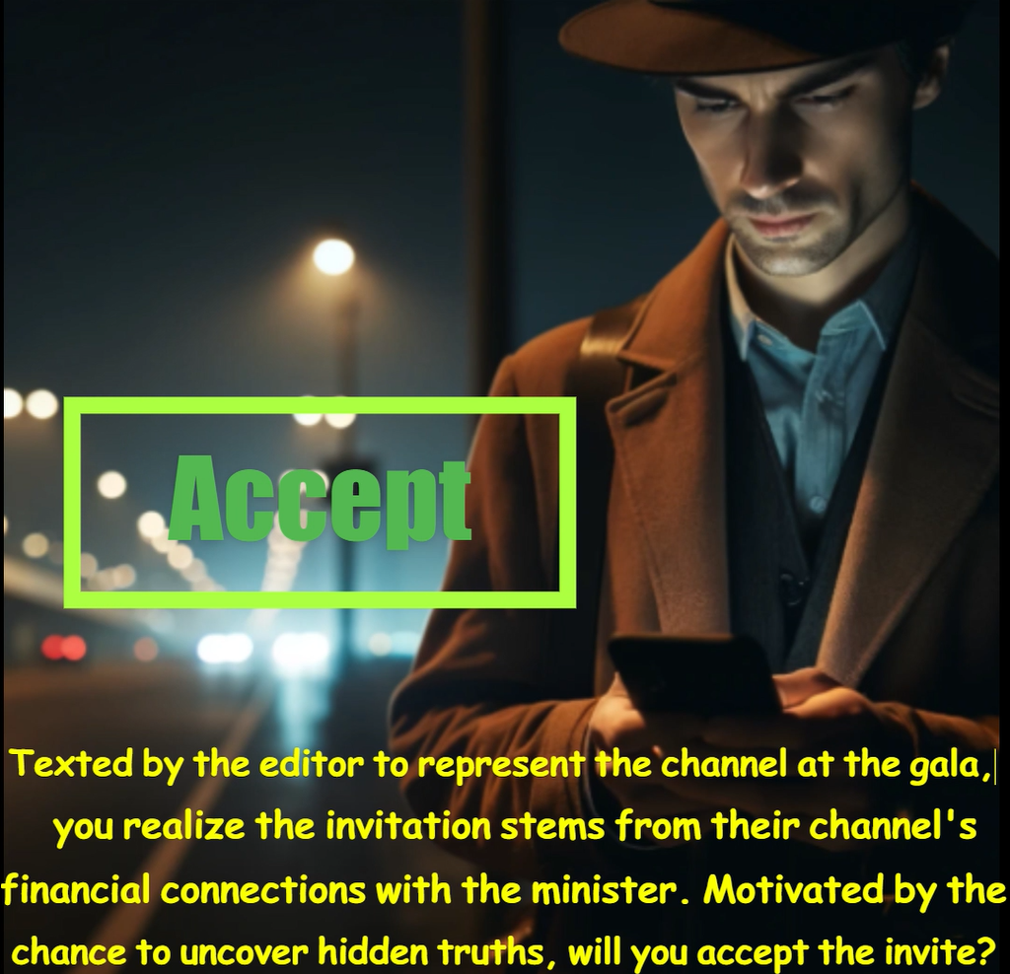
By some turn of events, the journalist gets an opportunity to attend the grand party held at the minister’s house, in celebration of the approval of the project …

Slide 5

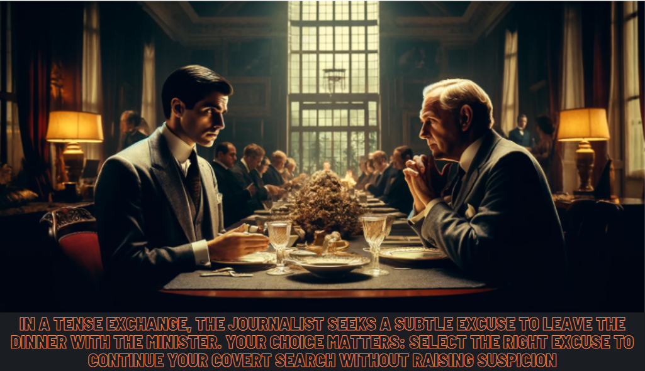
He capitalized on this chance to penetrate the enigmatic spaces of the minster’s mansion shielded from public view.

Slide 6
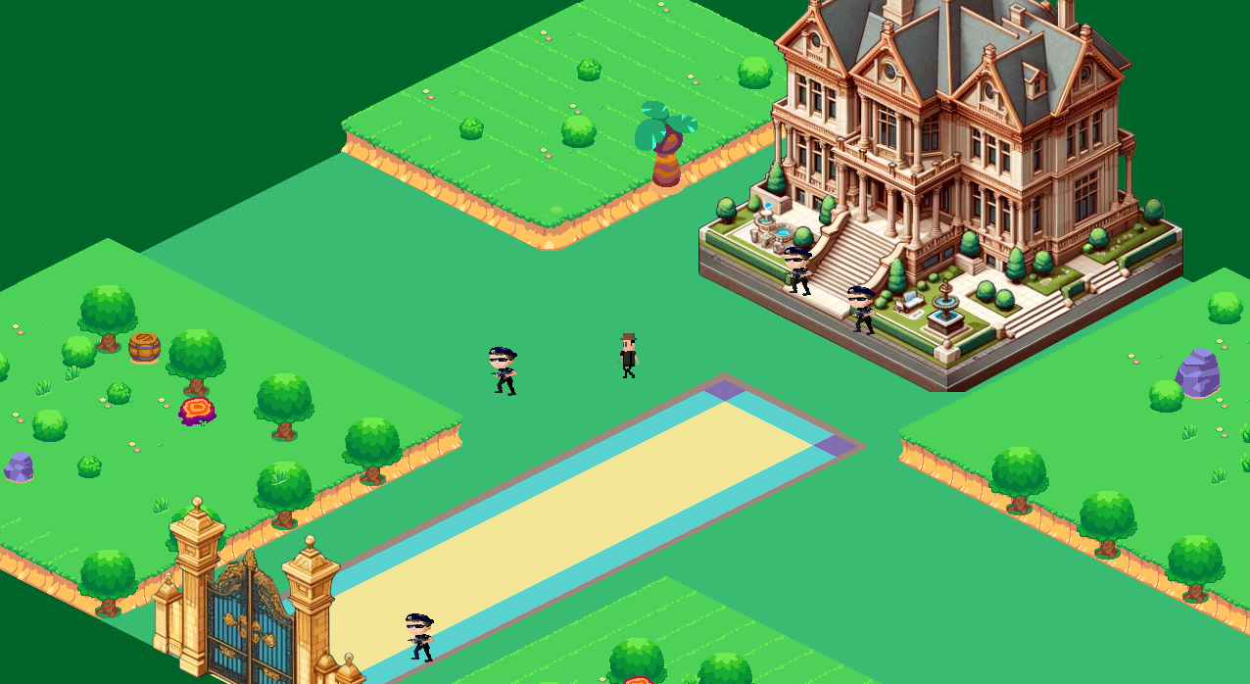
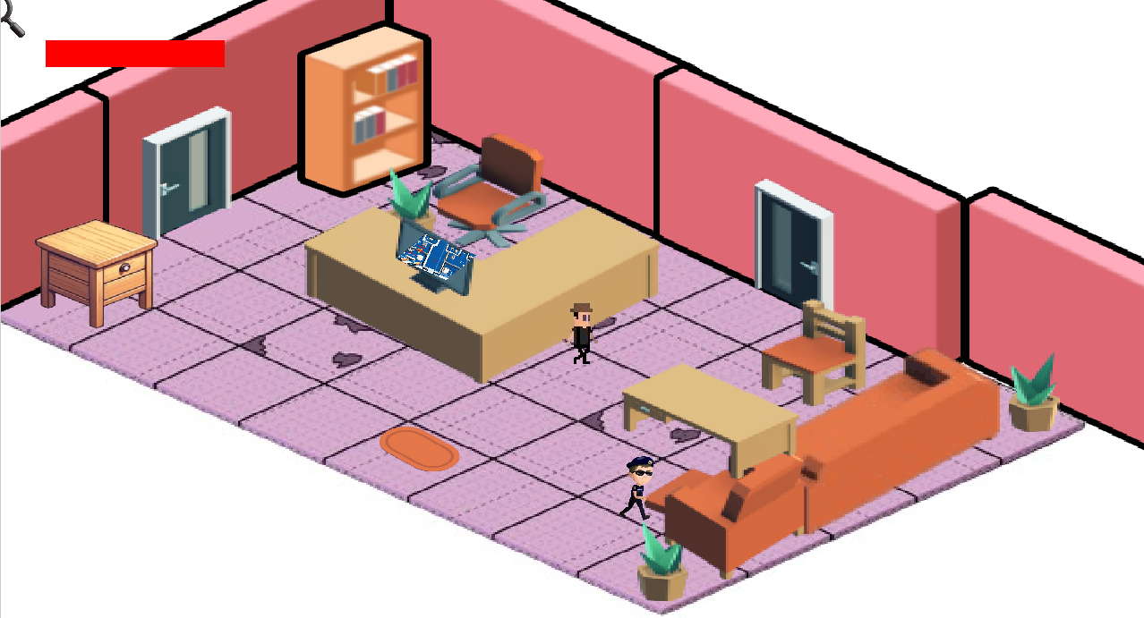
Outdoors
Reception/Lobby
With this story, the interactive part game begins. He starts off outside the mansion, makes his way inside the mansion, finding himself in the reception area …

Slide 7
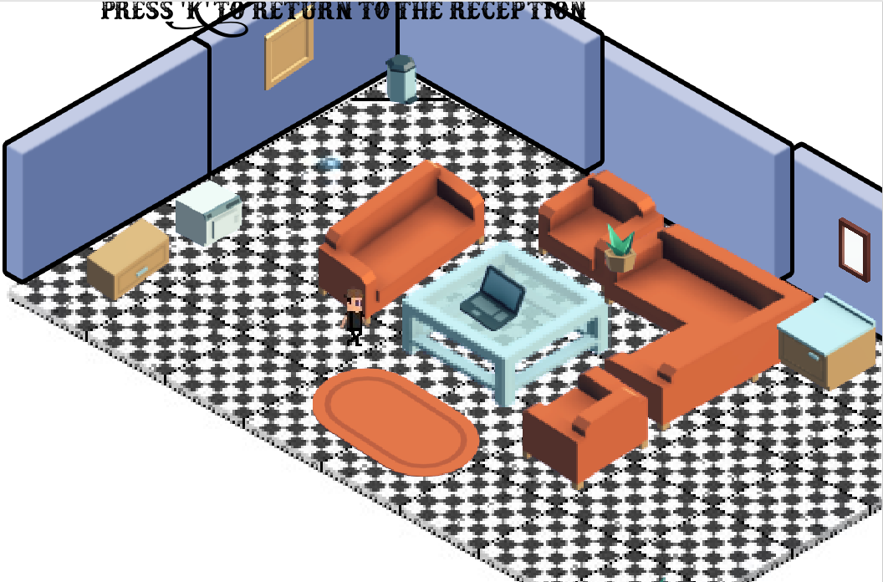
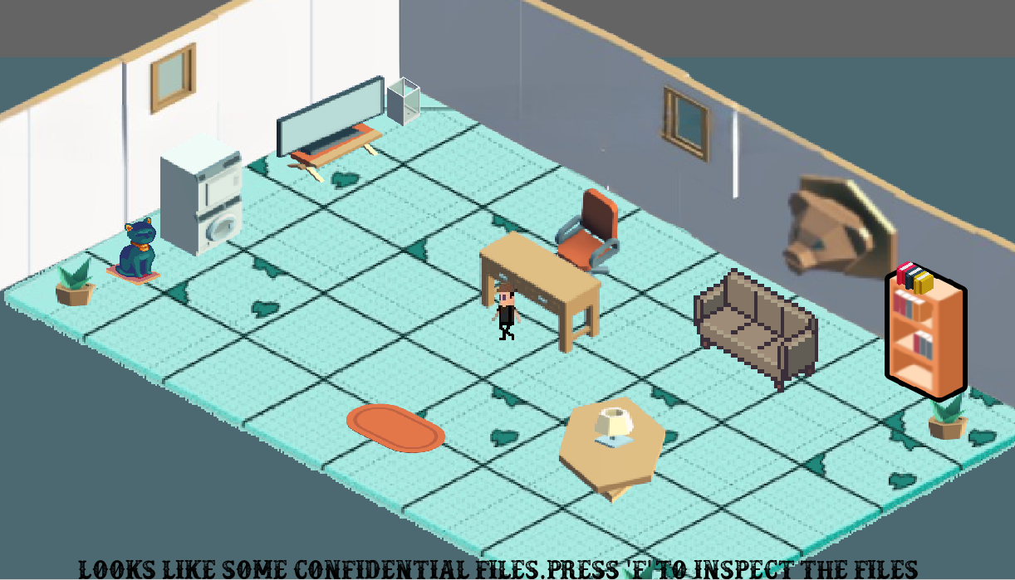
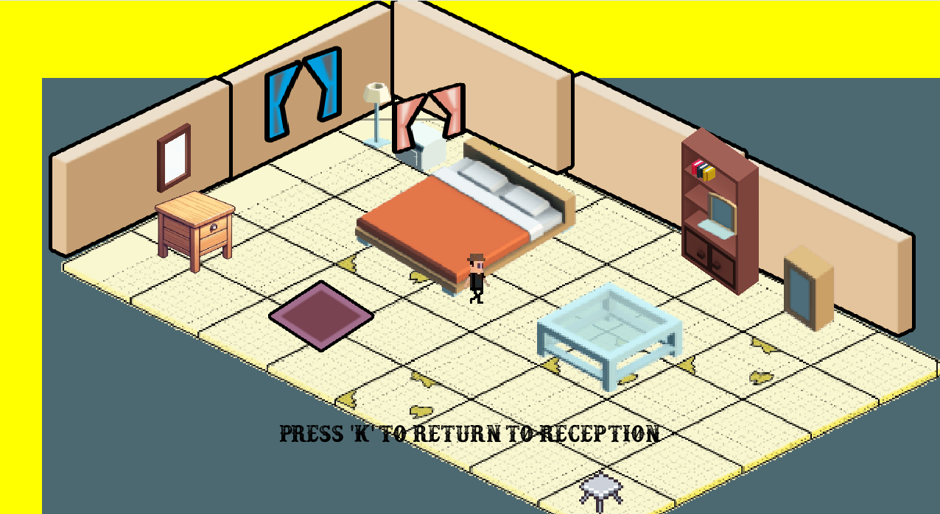
Our game consists of 5 levels: 1)The Outdoors 2)The reception/Lobby
3)The Bedroom 4)The Meeting Room
5)The Secret Room

Slide 8
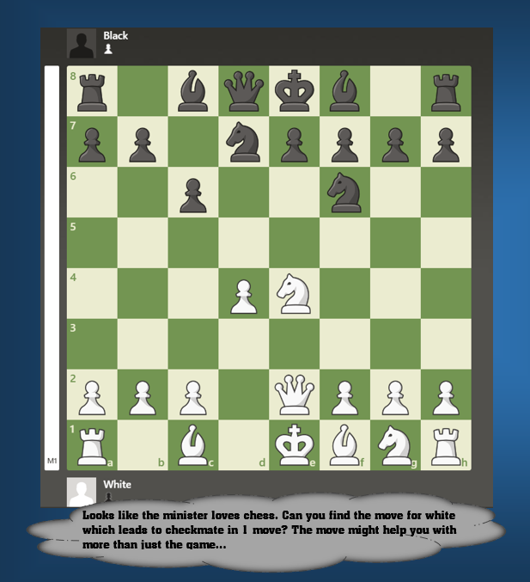

Navigating these levels requires him to Evade the Guards, find Hidden keys, and even solve elegant chess puzzles, wherein even a single moment of negligence might lead to him getting busted …

Slide 9
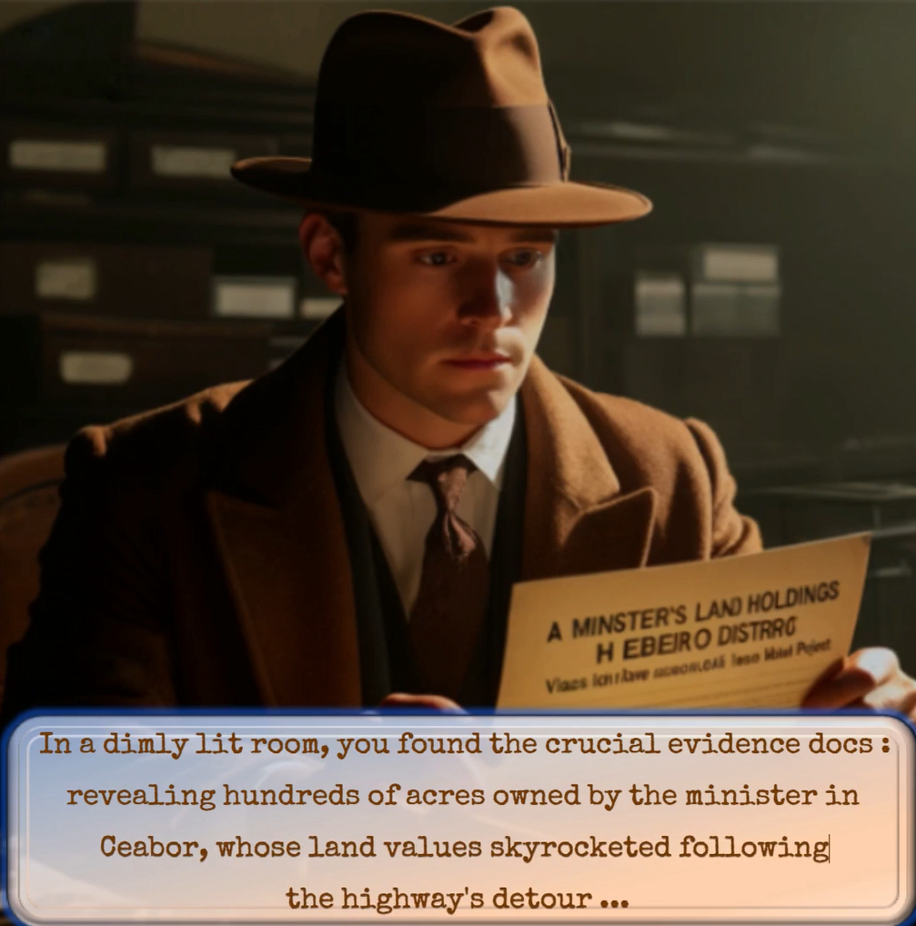

After a grueling ordeal, the journalist's relentless pursuit paid off when he discovered property documents showing the minister's ownership of extensive land holdings in Cebour, which surged in value tenfold because of the highway project

Slide 10


Now, With the journalist articulating such thoroughly substantiated claims, the news spreads like wildfire , becoming the talk of the town within a few days…

Slide 11
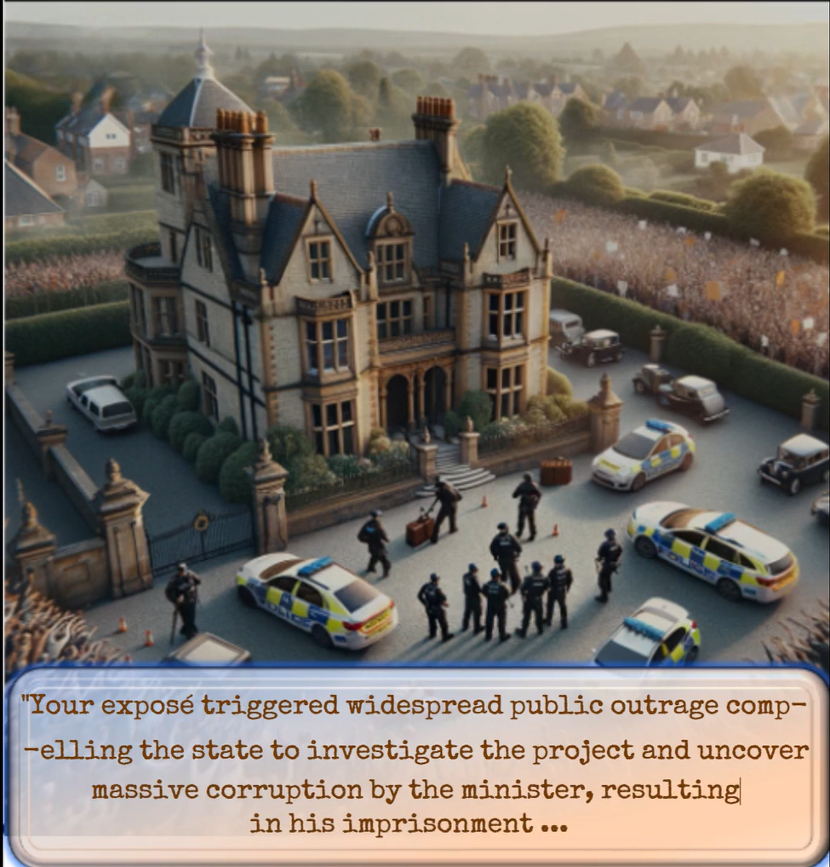

Public anger prompts the state to scrutinize the situation, which leads to the revelation of the minister's 2000 crore scam and puts him behind bars …

Slide 12

This press freedom’s day, on the 3rd march, Lets cherish the true souvenirs of our democracy …

Slide 13
Insights about the making of our game:
Firstly, we chose pygame to make our game, due to its simplicity, and availability of extensive online resources .
Then, we chose the isometric view for making the game, compared to the much simpler orthogonal (top) view, thereby giving a 3d perspective to our game .This, however, made our calculations, 10 times harder, if not more , as every time we had to impose any restriction on the movement of our character(due to boundaries/surrounding objects), we had we had to invoke some really intense trigonometry and geometry.

Slide 14
Insights about the making of our game:
Secondly, we chose “Tiled” as the software to make our maps , courtesy its easy integrability with pygame. We first designed 5 maps on Tiled(one for each level), and then incorporated them in our game, somewhat manually and somewhat elegantly.
For generating the necessary images, we used DALL-e, and other less popular AI tools
Image editing was also facilitated by tools like AI background remover, object removers,etc.

Slide 15
Insights about the making of our game:
To make the more engrossing, we decided to add the typewriter effect to our text, and also relevant audio like clicking sound ,sounds of opening drawers, acquiring keys ,all collected from different websites.
Video editing was highly facilitated by online platforms like ClipChamp(for typewriter effect), VideoTrimmer(for trimming the required parts of the video), Clideo(for applying a particular audio to a video), etc.

Slide 16
Insights about the making of our game:
One funny insight : Most of the AI tools/Editing tools that we mentioned above gave the output with a watermark. So, just like diamond cuts diamonds, we used online AI tools like “Watermark Remover”, “anieraser”,etc. to remove watermarks…
That’s why we feel like giving these softwares and websites their due credit.

Slide 17
Finally, Grading Parameters
The storyline is intricately crafted, offering a deeply engaging and vividly realistic experience that captivates players by immersing them in a meticulously detailed world.
The logic/rationale underpinning the game's design, which encompasses a puzzles, evading guards, and discovering concealed items, all demanding deep mathematical calculations courtesy our isometric perspective. As our game required many states, we have implemented it through a meticulously planned FSM, connecting the states, showing how one state leads to the other.
The sophisticated user interface, which integrates videos and images to elucidate the gameplay to the user.
Thank You

